Slide 1
TWIRRLL Workshop: Targeting Word Forms In Research-based Russian Language Learning
Laura A. Janda
UiT The Arctic University of Norway
Robert J. Reynolds
Brigham Young University
Francis M. Tyers
Высшая школа экономики, Москва

Slide 2
Overview
Evidence for strategically focusing learning on key forms and constructions (instead of full paradigms)
Presentation of Learners’ Constructicon of Russian and search functions of Russian National Corpus
Hands-on workshop in small groups
Reporting our results and crowdsourcing the Constructicon

Slide 3
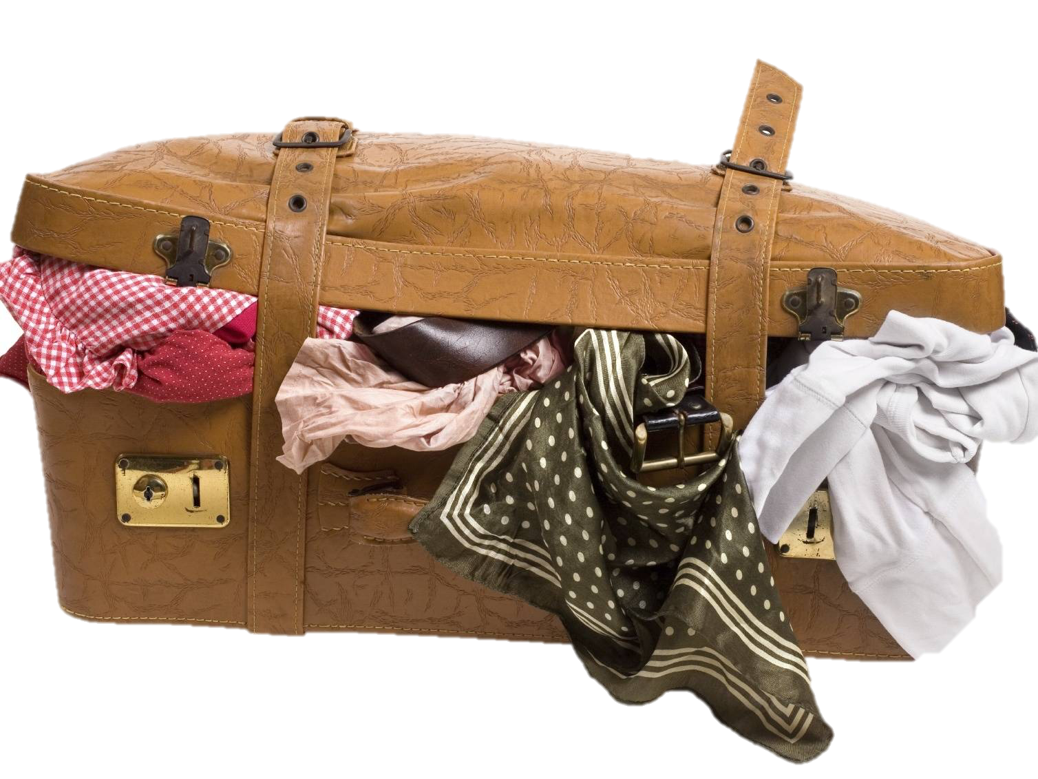
Evidence for strategically focusing learning on key forms and constructions (instead of full paradigms)
Russian and the relationship between paradigm size and number of full paradigms for nouns
There are 1-3 word forms that account for most of the frequency of any word
In aggregate, partially overlapping subsets of forms populate the space of the paradigm
Computational experiment comparing training on full paradigms vs. single forms
Memorizing full paradigms for all words is like overstuffing your suitcase

Slide 4
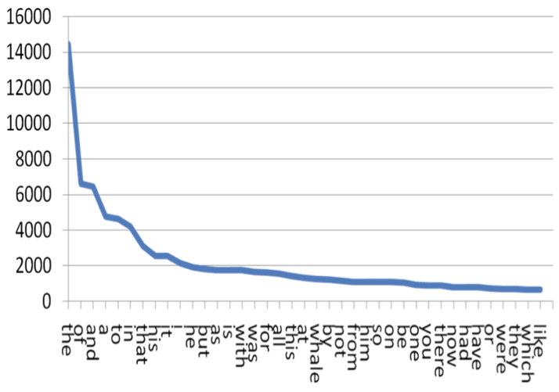
Zipf’s Law
Тhe frequency of a word is inversely proportional to its frequency rank
Zipf’s Law scales up infinitely
50% or more of all unique words are hapaxes

Slide 5
Zipf’s Law applies to word forms too
Language & Corpus Name | Corpus Size | Paradigm Size | Total Lexemes | Lexemes with full Paradigm | % Lexemes with full Paradigm
English Web Treebank | 254,830 | 2 | 6,369 | 1,524 | 23.92%
Norwegian Dependency Treebank | 311,277 | 4 | 12,587 | 393 | 3.12%
Russian SynTagRus | 1,032,644 | 12 | 21,945 | 13 | 0.06%
Czech Prague Dependency Treebank | 1,509,242 | 14 | 17,904 | 3 | 0.02%
Estonian ArborEst | 234,351 | 28 | 14,075 | 0 | 0%

Slide 6
Zipf’s Law applies to word forms too
Language & Corpus Name | Corpus Size | Paradigm Size | Total Lexemes | Lexemes with full Paradigm | % Lexemes with full Paradigm
English Web Treebank | 254,830 | 2 | 6,369 | 1,524 | 23.92%
Norwegian Dependency Treebank | 311,277 | 4 | 12,587 | 393 | 3.12%
Russian SynTagRus | 1,032,644 | 12 | 21,945 | 13 | 0.06%
Czech Prague Dependency Treebank | 1,509,242 | 14 | 17,904 | 3 | 0.02%
Estonian ArborEst | 234,351 | 28 | 14,075 | 0 | 0%
Because Zipf’s Law scales up, these numbers will never change substantially, no matter how large the corpus is

Slide 7
High-frequency Russian Nouns
‘fear’ ‘soldier’ ‘department’ ‘concept’ ‘memory’
Nsg | страх | солдат | отделение | концепция | память
Gsg | страха | солдата | отделения | концепции | памяти
Dsg | страху | солдату | отделению | концепции | памяти
Asg | страх | солдата | отделение | концепцию | память
Isg | страхом | солдатом | отделением | концепцией | памятью
Lsg | страхе |  | отделении | концепции | памяти
Npl | страхи | солдаты | отделения
Gpl | страхов | солдат | отделений | концепций
Dpl |  | солдатам
Apl | страхи | солдат | отделения | концепции
Ipl | страхами |  | отделениями | концепциями
Lpl | страхах | солдатах | отделениях
Key: bold >20%, plain >10%, grey 1-9%, (blank) unattested

Slide 8
More High-Frequency Russian Nouns
‘background’ ‘champion’ ‘extent’ ‘frame’ ‘difficulty’
Nsg | фон | чемпион |  |  | трудность
Gsg | фона | чемпиона |  |  | трудности
Dsg |  | чемпиону |  |  | трудности
Asg |  | чемпионa |  |  | трудность
Isg |  | чемпионом |  |  | трудностью
Lsg | фоне |  | протяжении
Npl |  | чемпионы |  | рамки | трудности
Gpl |  | чемпионов |  | рамок | трудностей
Dpl |  | чемпионам
Apl |  | чемпионов |  | рамки | трудности
Ipl |  | чемпионами |  | рамками | трудностями
Lpl |  |  |  | рамках | трудностях
Key: bold >20%, plain >10%, grey 1-9%, (blank) unattested

Slide 9
Masculine animates

Slide 10
Typically a lexeme is found in only 1-3 wordforms
Masculine animates

Slide 11
Typically a lexeme is found in only 1-3 wordforms
The typical wordforms
are motivated by constructions
Masculine animates

Slide 12
NomPl аналитики отмечают
‘analysts make the point that’
Typically a lexeme is found in only 1-3 wordforms
The typical wordforms
are motivated by constructions
InsSg стать/быть чемпионом
‘become/be the champion’
Masculine animates

Slide 13
Computational experiment: nouns, verbs, adjectives
Based on an ordered list of the most frequent forms in SynTagRus
Machine learning:
Given the 100 most frequent forms, predict the next 100 most frequent forms
Given the 200 most frequent forms, predict the next 100 most frequent forms
Given the 300 most frequent forms, predict the next 100 most frequent forms
Given the 400 most frequent forms, predict the next 100 most frequent forms
Given the 500 most frequent forms, predict the next 100 most frequent forms
… until 5400, when SynTagRus runs out of data

Slide 14
Computational experiment: nouns, verbs, adjectives
This is the training data
Based on an ordered list of the most frequent forms in SynTagRus
Machine learning:
Given the 100 most frequent forms, predict the next 100 most frequent forms
Given the 200 most frequent forms, predict the next 100 most frequent forms
Given the 300 most frequent forms, predict the next 100 most frequent forms
Given the 400 most frequent forms, predict the next 100 most frequent forms
Given the 500 most frequent forms, predict the next 100 most frequent forms
… until 5400, when SynTagRus runs out of data

Slide 15
Computational experiment: nouns, verbs, adjectives
This is the testing data
Based on an ordered list of the most frequent forms in SynTagRus
Machine learning:
Given the 100 most frequent forms, predict the next 100 most frequent forms
Given the 200 most frequent forms, predict the next 100 most frequent forms
Given the 300 most frequent forms, predict the next 100 most frequent forms
Given the 400 most frequent forms, predict the next 100 most frequent forms
Given the 500 most frequent forms, predict the next 100 most frequent forms
… until 5400, when SynTagRus runs out of data

Slide 16
Data for training and testing from SynTagRus
Frequency & Form | Lemma | POS | Parse of form
1447 может | мочь | VERB | Aspect=Imp|Mood=Ind|Number=Sing|Person=3|Tense=Pres|VerbForm=Fin|Voice=Act
1286 года | год | NOUN | Animacy=Inan|Case=Gen|Gender=Masc|Number=Sing
999 лет | год | NOUN | Animacy=Inan|Case=Gen|Gender=Masc|Number=Plur
832 году | год | NOUN | Animacy=Inan|Case=Loc|Gender=Masc|Number=Sing
813 время | время | NOUN | Animacy=Inan|Case=Acc|Gender=Neut|Number=Sing
678 россии | россия | NOUN | Animacy=Inan|Case=Gen|Gender=Fem|Number=Sing
571 могут | мочь | VERB | Aspect=Imp|Mood=Ind|Number=Plur|Person=3|Tense=Pres|VerbForm=Fin|Voice=Act
571 люди | человек | NOUN | Animacy=Anim|Case=Nom|Gender=Masc|Number=Plur
543 россии | россия | NOUN | Animacy=Inan|Case=Loc|Gender=Fem|Number=Sing
436 является | являться | VERB | Aspect=Imp|Mood=Ind|Number=Sing|Person=3|Tense=Pres|VerbForm=Fin|Voice=Act
416 случае | случай | NOUN | Animacy=Inan|Case=Loc|Gender=Masc|Number=Sing
411 людей | человек | NOUN | Animacy=Anim|Case=Gen|Gender=Masc|Number=Plur
403 страны | страна | NOUN | Animacy=Inan|Case=Gen|Gender=Fem|Number=Sing
400 жизни | жизнь | NOUN | Animacy=Inan|Case=Gen|Gender=Fem|Number=Sing

Slide 17
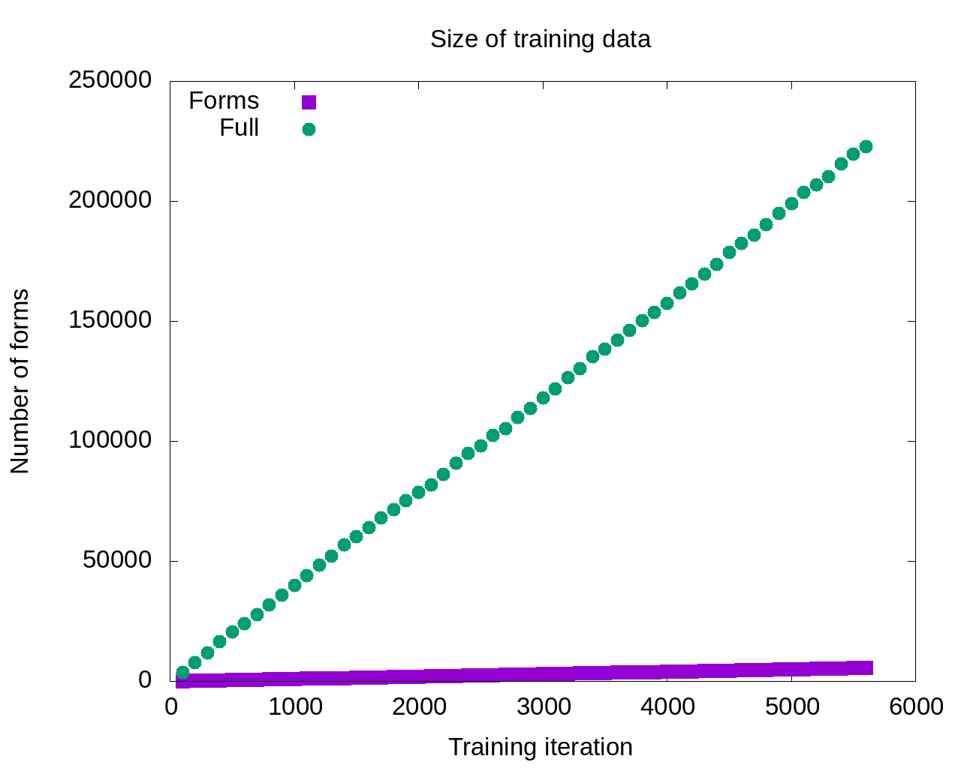

Slide 18
So the model that gets the most input should be the most successful, right?

Slide 19
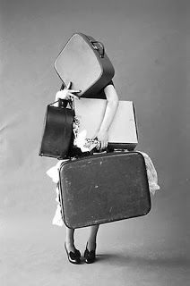
Maybe not…
So the model that gets the most input should be the most successful, right?

Slide 20
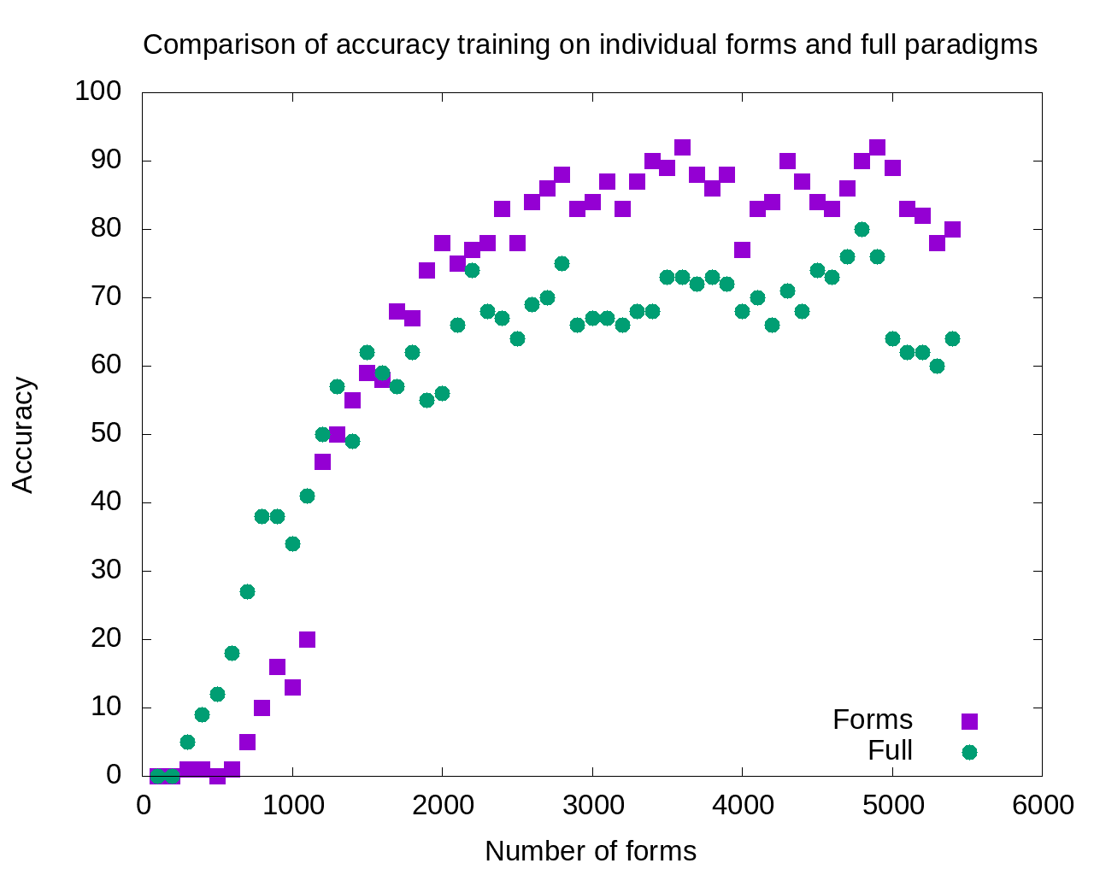

Slide 21
1800-5400:
Single forms model outperforms
full paradigms

Slide 22
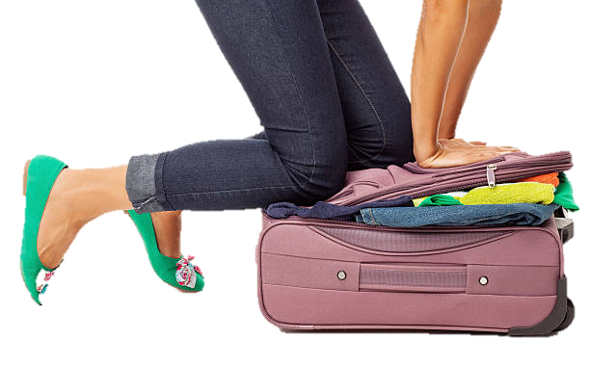
Excess data is probably overpopulating the search domain

Slide 23
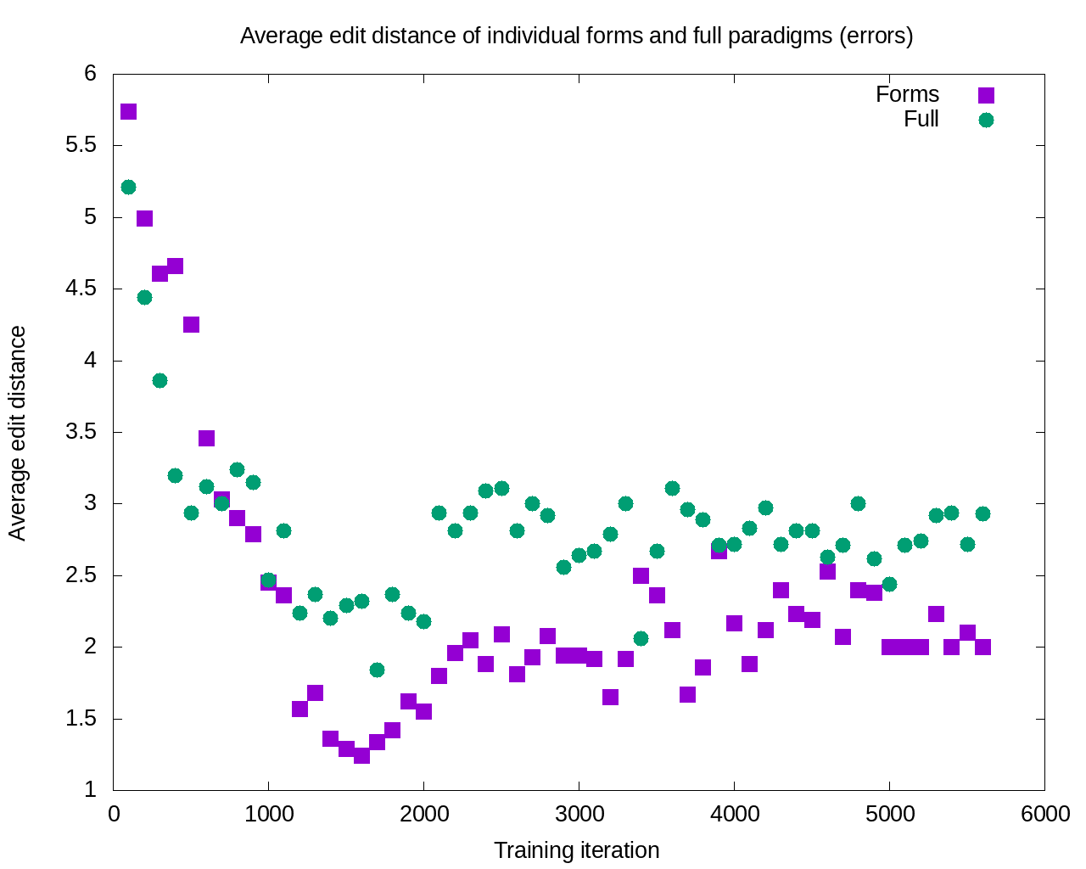

Slide 24
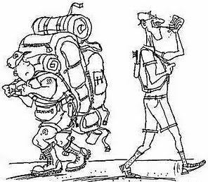
After 11 iterations, the errors committed by the single forms model are consistently smaller

Slide 25
What this means
A given word typically appears in only a handful of forms
Those word forms are motivated by constructions and collocations most typical for the word
Learning is potentially enhanced by focus only on the most typical word forms attested for given lexemes: accuracy increases and severity of errors decreases

Slide 26
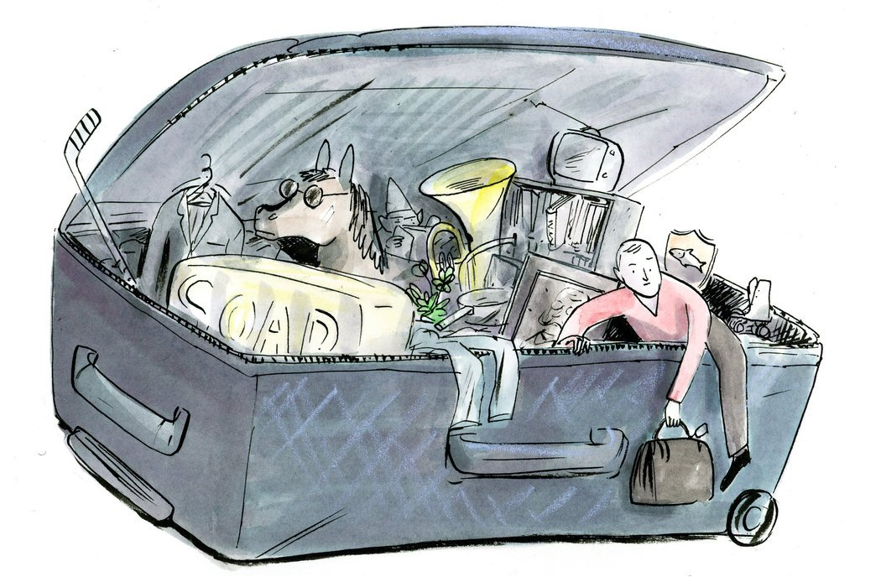
So how can we escape from this overstuffed suitcase?
Textbooks have always focused on certain forms and constructions
Now we can do this in a scientific, consistent way

Slide 27

Find the 1-3 most common forms of the high-frequency words students need to know
Find the grammatical constructions that motivate those 1-3 word forms

Slide 28
1-3 most common forms of high-frequency words
We’ve already made some samples for you
Each handout lists 9 high-frequency words (≥50 in SynTagRus)
For each word, the list shows the 3 most frequent forms
Please form pairs or small groups, each group can use 1 of 20 lists

Slide 29
Find the grammatical constructions that motivate those 1-3 word forms
Use the Russian National Corpus
http://ruscorpora.ru/
Find constructions for the Learner’s Constructicon for Russian
https://spraakbanken.gu.se/karp/#?mode=konstruktikon-rus
Enter suggestions in our Russian Constructicon crowdsourcing sheet:
https://tinyurl.com/ybfqzh9n; https://tinyurl.com/yah8ejlu
Let’s try a demo first

Slide 30

слово appears 814 times in SynTagRus
Can you guess what its most frequent form is?

Slide 31
слово appears 814 times in SynTagRus
Can you guess what its most frequent form is?
словам (280 = 34.4%)
слова (212 = 26%)
слово (118 = 14.5%)
Notes:
We can also try связи…

Slide 32
How to look for motivating constructions in the Russian National Corpus
Exact string search (cannot contain punctuation)
Lexeme + grammatical features search
Notes:
We can also try связи…

Slide 33
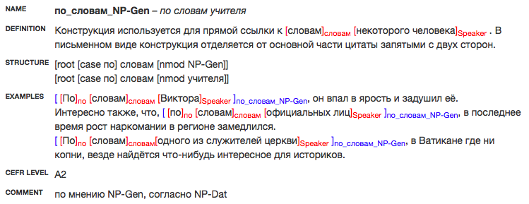
An Entry in the Constructicon:

Slide 34
An Entry in the Constructicon:
NAME renders the construction both schematically and with a brief example

Slide 35
DEFINITION explains the meaning of the construction (all definitions will also be translated into English)
An Entry in the Constructicon:

Slide 36
An Entry in the Constructicon:
STRUCTURE provides a dependency grammar analysis of both the schematic and brief example renderings of the construction

Slide 37
An Entry in the Constructicon:
At least three corpus EXAMPLES illustrate the construction

Slide 38
An Entry in the Constructicon:
CEFR is the Common European Framework of Reference for Languages level to guide learners and instructors

Slide 39
Try out your lists
and enter suggested constructions in our Googlesheet!
https://tinyurl.com/yah8ejlu

Slide 40

What can we do?
Use corpora to find the word forms that are most strategic for our students
Crowdsource the Constructicon for Russian
Build learning materials that focus on the typical word forms, avoiding unlikely word forms
Thank you!

